Slide 1

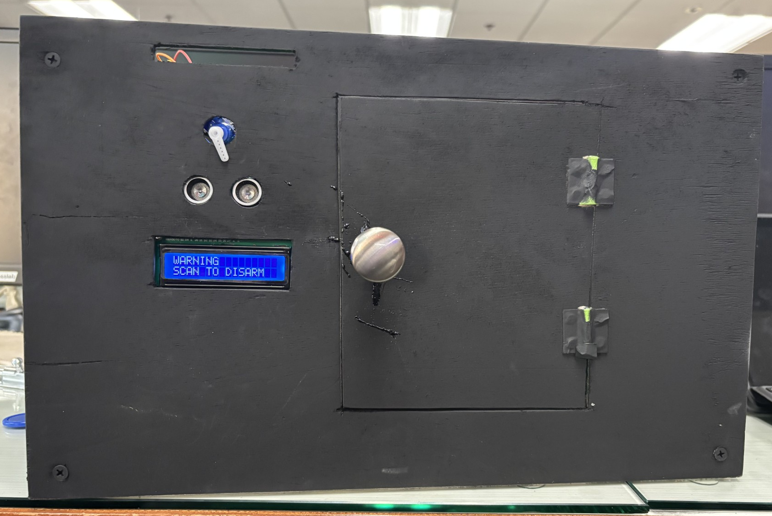
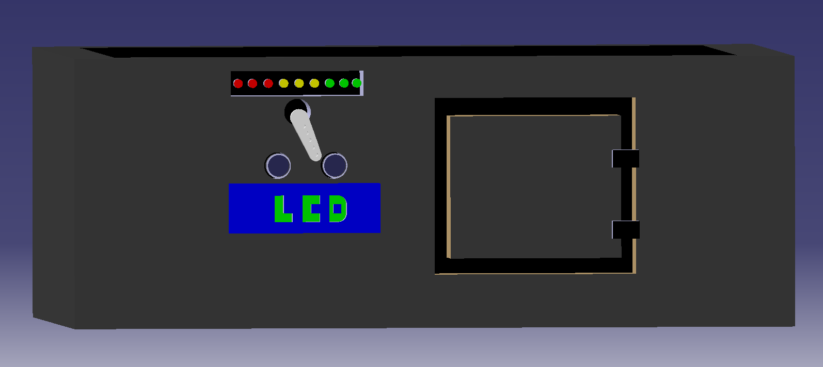
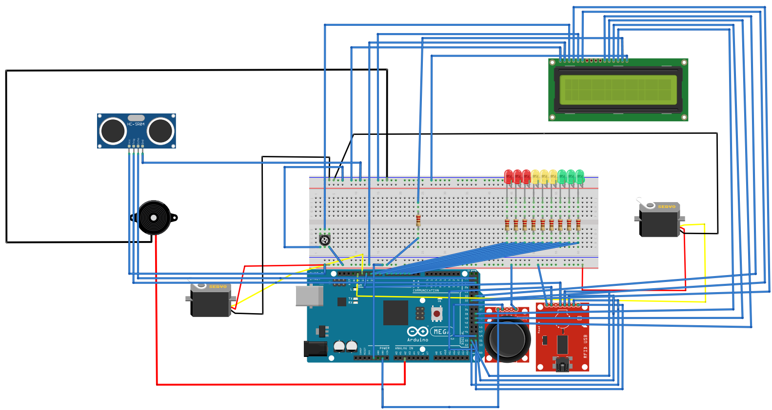
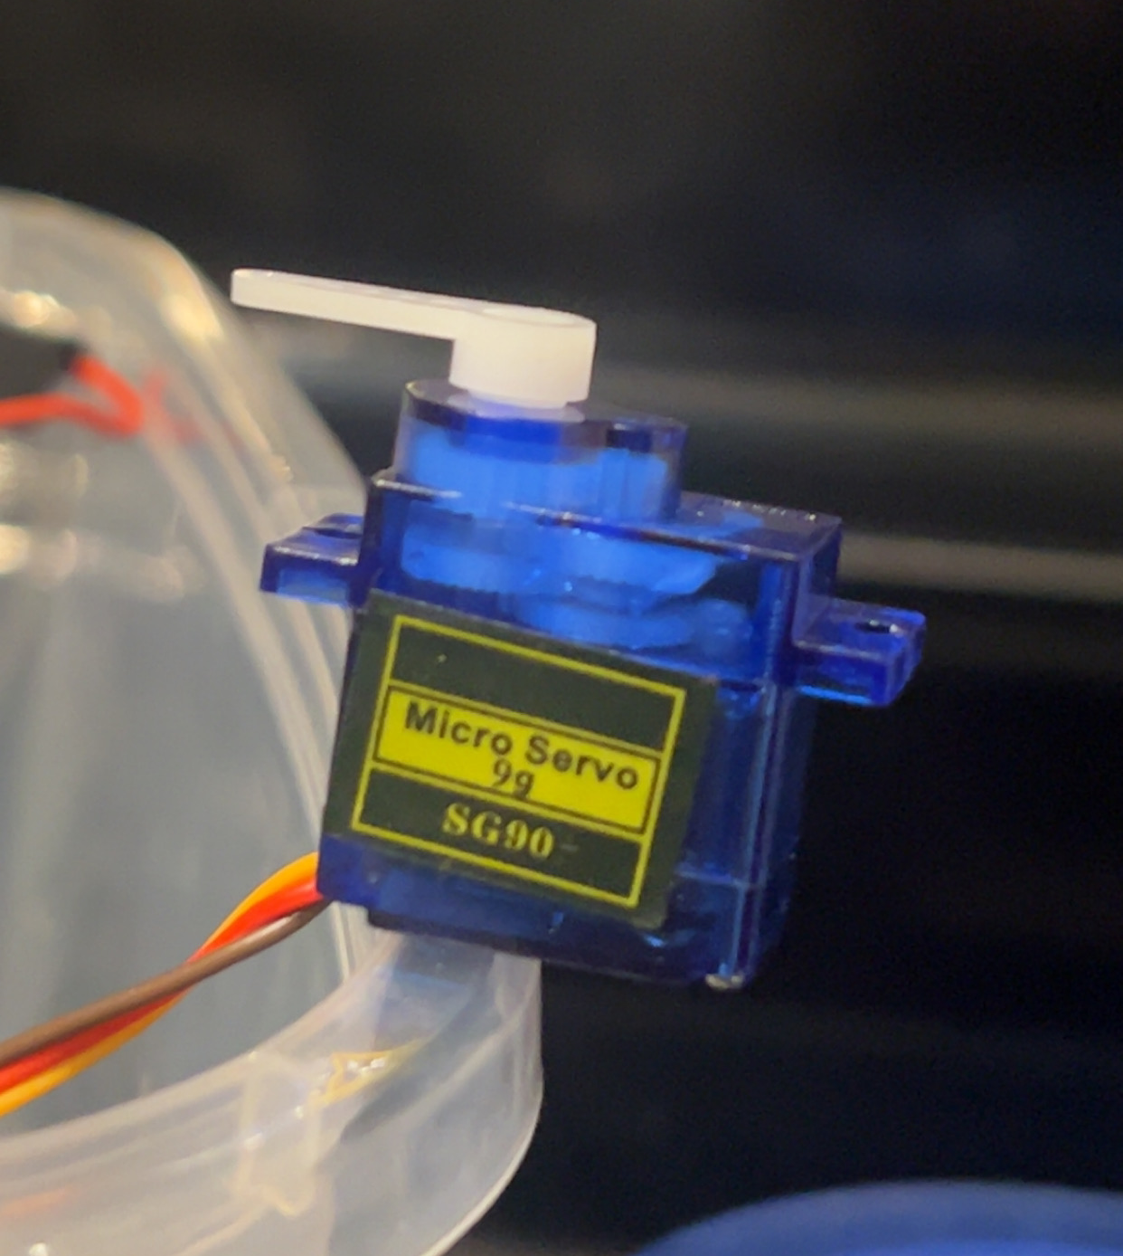
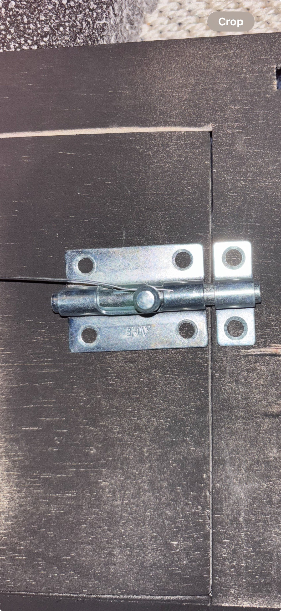
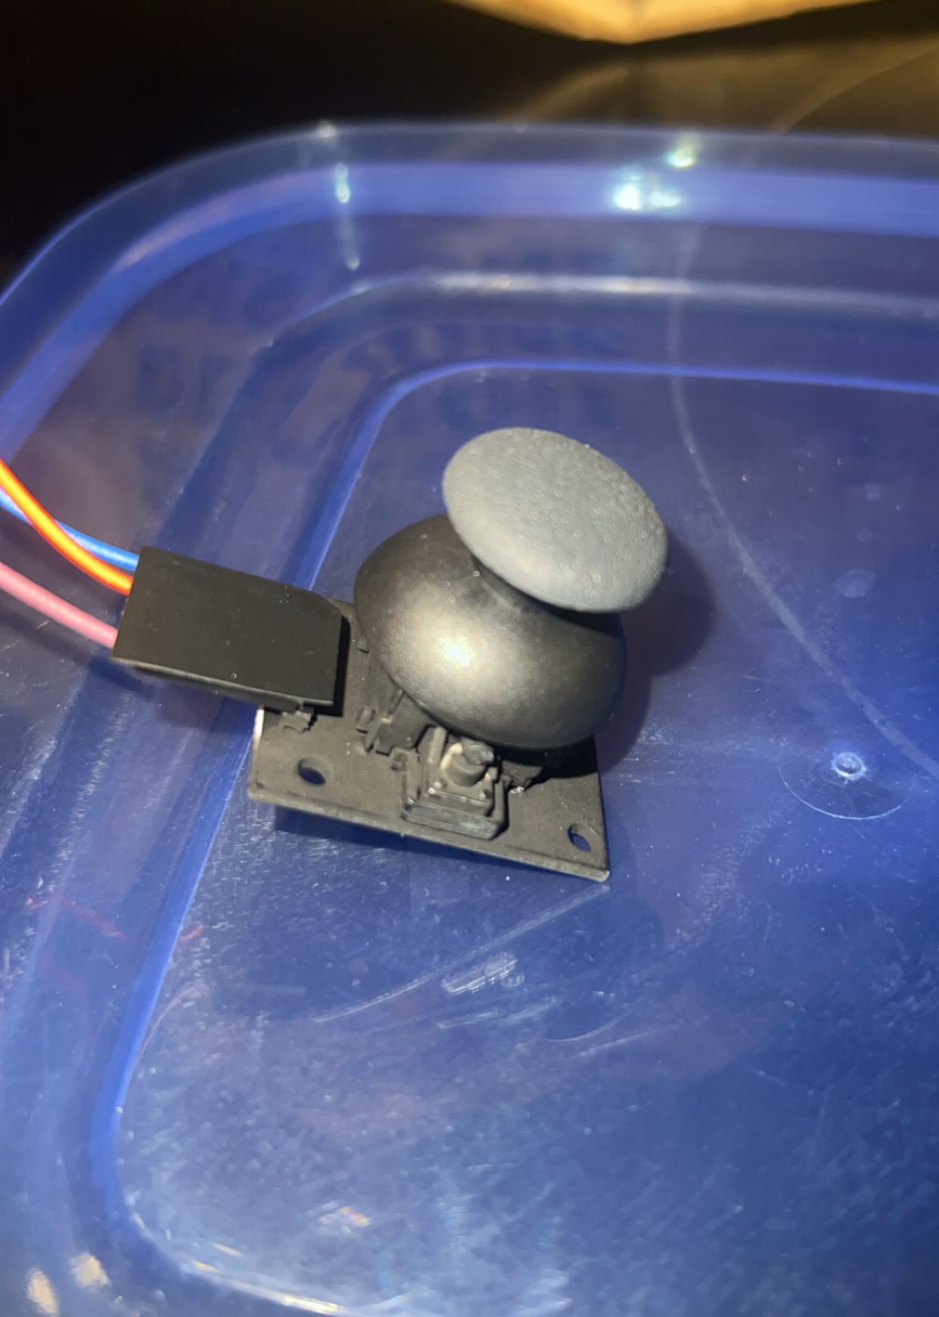
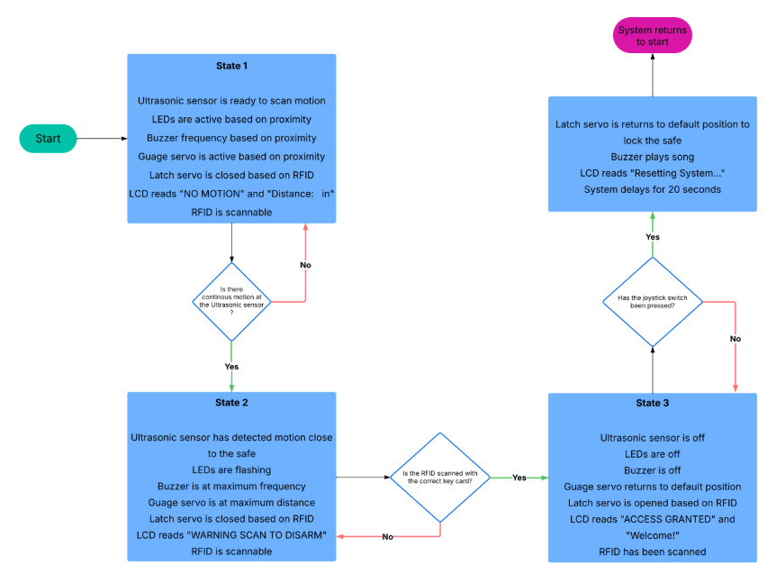
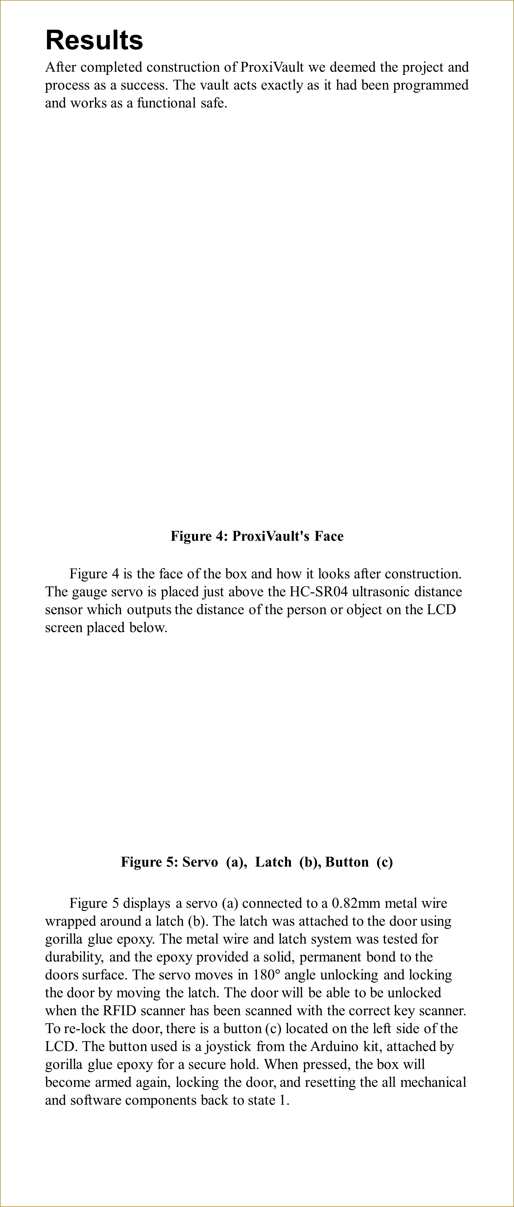
ProxiVault: Where Movement Triggers Mayhem, Until You Scan In
A. Konja, A. Dikho, L. Petterle, and L. Zora
EGR280 Final Project – Fall 2025
School of Engineering and Computer Science, Oakland University
Instructors: Prof. O. Rawashdeh and Prof. M. Romagnoli
Introduction
Want to get robbed? We didn’t think so! Meet ProxiVault, a high security, alarm equipped safe. The safe features a distance sensor, alarm, lighting display, key card access, and an LCD screen indicating what state the safe is in. The door is controlled by an RFID sensor which when applied with a proper scan, will The safe will perform these actions using the following coded equipment: 2 Servos, 1 Buzzer, 1 HC-SR04 Ultrasonic distance sensor, 9 LEDs,1 LCD Screen, 1 joystick, and 1 RFID. The front of the system will have a gauge controlled by a servo, measuring the distance. This alarm system can be applied in numerous real-world scenarios such as home security (jewelry, cash, and personal belongings), small business (cash protection), medical offices (drug, record protection), etc.
Results
After completed construction of ProxiVault we deemed the project and process as a success. The vault acts exactly as it had been programmed and works as a functional safe.
Figure 4: ProxiVault's Face
Figure 4 is the face of the box and how it looks after construction. The gauge servo is placed just above the HC-SR04 ultrasonic distance sensor which outputs the distance of the person or object on the LCD screen placed below.
Figure 5: Servo (a), Latch (b), Button (c)
Figure 5 displays a servo (a) connected to a 0.82mm metal wire wrapped around a latch (b). The latch was attached to the door using gorilla glue epoxy. The metal wire and latch system was tested for durability, and the epoxy provided a solid, permanent bond to the doors surface. The servo moves in 180$°$ angle unlocking and locking the door by moving the latch. The door will be able to be unlocked when the RFID scanner has been scanned with the correct key scanner. To re-lock the door, there is a button (c) located on the left side of the LCD. The button used is a joystick from the Arduino kit, attached by gorilla glue epoxy for a secure hold. When pressed, the box will become armed again, locking the door, and resetting the all mechanical and software components back to state 1.
Design
ProxiVault is built out of wooden planks and panels whose dimensions are 12" long, 16" wide and 12" in height. The framework is wood glued together and parts of the wood are cut out to accommodate the placement of the electrical and mechanical components.
Figure 2: Electrical Configuration
Figure 2 displays how the electrical components are used on and in the box. The ultra sonic buzzer on the side is used to alarm the intruder and everyone near. The LCD is used to display the state, while also paring with a lighting color. The lights work in a set of three colors: green, yellow and red -- which light up based on the distances detected. The RFID is used to disarm the system and unlock the box, which is functioned by a servo inside pulling on a lack to unlock. As well as a servo displaying distance above the LCD. The button will be placed on the outside, when pressed rearming the system.
Figure 3: State Machine
Figure 3 displays the state machine used to demonstrate the process of the safe. State 1 detects motion with an ultrasonic sensor, activating LEDs, a buzzer, a gauge servo based on proximity, and a latch servo via RFID while the LCD displays “Stand by.” In State 2, motion is detected near the safe, triggering flashing LEDs, a max-frequency buzzer, a fully extended gauge servo, a locked latch servo, and an LCD prompting to "Scan RFID To Disarm.” In State 3, After a successful RFID scan, the system shuts down all alerts, resets the gauge servo, unlocks the latch, and the LCD displays “Access Granted.”
Conclusion
ProxiVault has multiple purposes in real world settings, such as home security (for jewelry, cash, and personal items), small businesses (for secure cash storage), and medical offices (for drug or record protection). ProxiVault helps keeps the community safe and decrease theft. The goal was to create a motion-triggered smart safe using ultrasonic sensors, servo rotation, with visual and audible alerts. The final prototype functioned reliably and met the design expectations.
ProxiVault is an effective way to save a business time and money by always making sure their most valuable assets are secure from intruders. Equipped with distance and radio frequency sensing capabilities ProxiVault is the perfect addition to your home or business if safety is your number one priority, because it sure is ours!

